Slide 1
Title: Agile Development Practices, Explained
Given at:
Job Hackers, San Francisco, Aug 2019
Agile2018
Description:
Agile isn’t about preventing mistakes, it’s about making mistakes cheaper. Years ago I was on a project that seemed to make every mistake a project can make. Let’s take a stroll down memory lane and look at all the mistakes that could and did go wrong and which of the 6 agile development practices helps us not to prevent the mistake, but to make it so cheap as to not be worth remembering. The 6 Development practices: Onsite customer Pair Programming Refactoring Continuous Integration Test Driven Development Iterative Development
Learning Outcomes: How to reduce the costs of mistake around:
Doing what is asked but not wanted.
Misestimating what % is done
Bugs
Misunderstanding requirements
Employee turnover
Hard to understand code
Notes:
Title: Agile Development Practices, Explained
Given at:
Job Hackers, San Francisco, Aug 2019
Agile2018
Description:
Agile isn’t about preventing mistakes, it’s about making mistakes cheaper. Years ago I was on a project that seemed to make every mistake a project can make. Let’s take a stroll down memory lane and look at all the mistakes that could and did go wrong and which of the 6 agile development practices helps us not to prevent the mistake, but to make it so cheap as to not be worth remembering. The 6 Development practices: Onsite customer Pair Programming Refactoring Continuous Integration Test Driven Development Iterative Development
Learning Outcomes: How to reduce the costs of mistake around:
Doing what is asked but not wanted.
Misestimating what % is done
Bugs
Misunderstanding requirements
Employee turnover
Hard to understand code

Slide 2
Agile Development Practices, Explained
@Llewellyn Falco

Slide 3
Dice
Notes:
7, 9, 5, 6, 3
7, 6, 5, 8, 4, 11
5,9,10

Slide 4
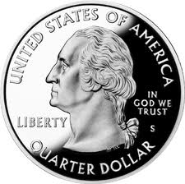
Demo - Beginner Programming
Website
Mistakes : 11
Cost: $2.75
Shopping Cart
I didn’t mean…
In my browser…
This page is too…
This loads to slow…
Ship it!
Too hard to…
This layout is confusing…
It needs icons…
There’s a bug when…
Need Email confirmation…
Ship it!
The Items aren’t…
The ordering is incorrect…
Recommendations
Ship It!
Notes:
7, 9, 5, 6, 3
7, 6, 5, 8, 4, 11
5,9,10

Slide 5
Demo – Waterfall
Website
Mistakes : 7
Cost: $1.75
Shopping Cart
Ship It!
When I said blue…
This page isn’t quite…
Too much…
Too few…
Ship It!
People are manipulating…
People are manipulating…
This isn’t right…
Ship it!
Recommendations
Notes:
#8 – 2, 10
#7 – 2 8
#2 – 3 5

Slide 6
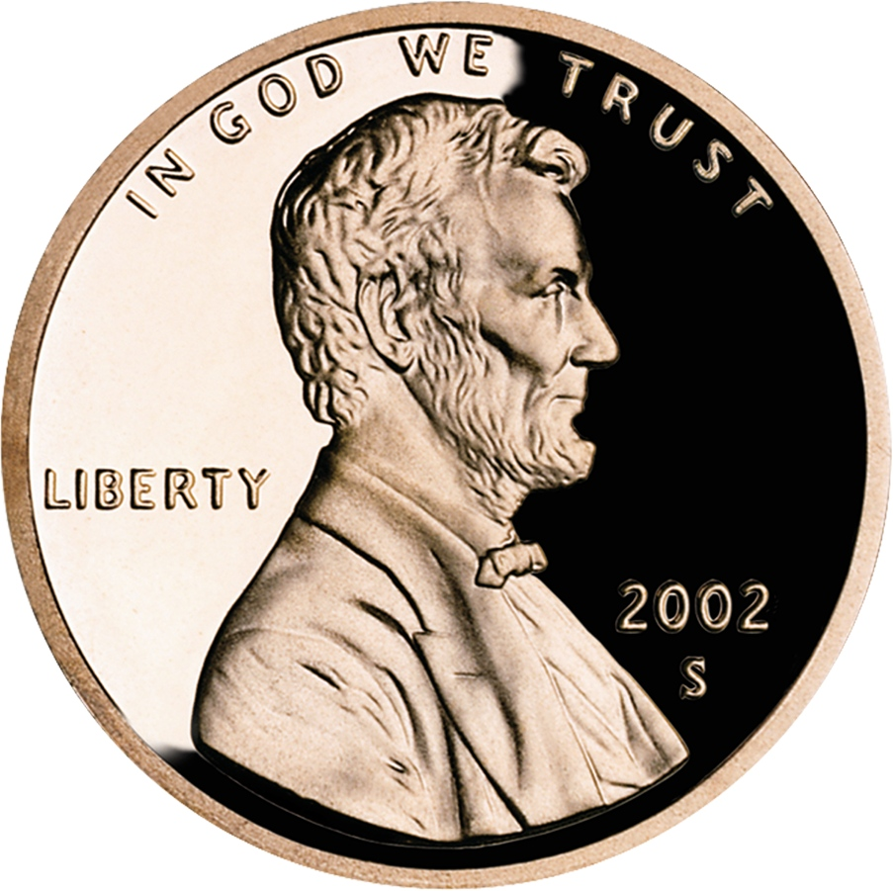
Demo – Agile
Website
Mistakes : 19
Cost: 19₵
Shopping Cart
Not that Color…
More…
The logo’s not…
Can it be…?
Ship it!
It needs…
But maybe…
And icons…
With emails…
But they show in spam…
It’s missing…
The bug occurs…
Ship it!
A bit bigger…
It needs…
Some of the suggestions…
It should have a…
It should display text…
… and icons …
… and prices …
There’s a bug when …
Ship it!
Recommendations
Notes:
7 ,8,9,10,11
7,8,9,10,11,12,6,5,4
2,3,4,5,6,7,8,9

Slide 7
Methodologies

Slide 8
Core Agile Value Reduce the Cost of Mistakes
Ways to mitigate the cost of mistakes
Detection (early)
Change (easy)
Area of Effect (reduced)
Notes:
Wheelchair story.
Touch hot barbegue
Database story.

Slide 9
Mistake #1
Notes:
We set out to create a purchase system for Acme Corp. After 4 months, we demoed to the customer. They said, what about when we have to have PO orders. I replied, your requirement never mentioned anything other than up front payments, and when we spoke you said you never did any other type. They replied, well we basically never do, it’s only once or twice a year.

Slide 10
What was the Mistake?
Misunderstood Requirement
How would you mitigate the cost of mistakes?
Detection (early)
Change (easy)
Area of Effect (reduced)

Slide 11

Never say Never Misunderstood Requirement
Requirements
Demo
Notes:
Where would you have liked to know about this?

Slide 12
Recap #1 Misunderstood Requirement
Agile Practice
Issue
First Steps
Common Mistakes
Resources
Onsite Customer
Detection
1 customer, use your own product
Business analyst. Trust. Tunnel Vision
Lean Software Development by Mary Poppendieck
www.industrialxp.org/sittingTogether.html

Slide 13
Mistake #2
Notes:
A week before the next demo, our DBA fell in love and ran off to get married & honeymoon. We couldn’t do anything, and ended up missing the demo.

Slide 14
What was the Mistake?
Knowledge Silo
How would you mitigate the cost of mistakes?
Detection (early)
Change (easy)
Area of Effect (reduced)

Slide 15
Recap #2 Knowledge Silo
Agile Practice
Issue
First Steps
Common Mistakes
Resources
Pair Programming / Mob Programming
Change
½ hour a day, everyday or
90 mins 1-3 times a week
1 person watching
Pair Programming Illuminated by Laurie Williams
mobprogrammingguidebook.com

Slide 16
Mistake #3
Notes:
At Mix they announced Windows Phone 7 & how it’s easy to convert from WPF if you’ve been doing proper MVVP. The next day, the client needed it to work on phones. It took 3 weeks before our code base even compiled again, and 3 months before it was working again on the phones.

Slide 17
What was the Mistake?
Changing Requirement
How would you mitigate the cost of mistakes?
Detection (early)
Change (easy)
Area of Effect (reduced)

Slide 18
Recap #3 Changing Requirement
Agile Practice
Issue
First Steps
Common Mistakes
Resources
Refactoring
Change
2 minute steps. Automatic Refactorings
Rewrites, Adding Functionality
Working Effectively w/Legacy Code by Michael Feathers
Clean Code by Robert Martin

Slide 19
Mistake #4
Notes:
By this time there were a few teams to handle the different modules. We

Slide 20
What was the Mistake?
Integration
How would you mitigate the cost of mistakes?
Detection (early)
Change (easy)
Area of Effect (reduced)

Slide 21
Recap #4 Integration
Agile Practice
Issue
First Steps
Common Mistakes
Resources
Continuous Integration
Detection, Area of Effect
Automated Build, Source Control
Killing the messenger
CI: TFS, CruiseControl, Hudson, Team City.
SourceControl: TFS, SVN, Git, Mercurial, Tortoise*
Build: MsBuild, Nant

Slide 22
Mistake #5
Notes:
At Mix they announce Windows Phone 7 & how it’s easy to convert from WPF. The next day, the client needed it to work on phones.

Slide 23
What was the Mistake?
Bugs
How would you mitigate the cost of mistakes?
Detection (early)
Change (easy)
Area of Effect (reduced)

Slide 24

Bugs
Start Code
End Code
QA

Slide 25
Recap #5 Bugs
Agile Practice
Issue
First Steps
Common Mistakes
Resources
Test Driven Development
Detection
Write steps in English
Test after
Frameworks: MSTest, Nunit
Book: Test Driven Development, Kent Beck

Slide 26
Test Driven Development ( TDD)
// make a new order
// buy 10 shirts at $100 each
// set sales tax to 10%
// verify order total
var order = new Order();
order.AddItem(item: “Shirt”, amount: 10, unitPrice: 100);
order.SalesTax = 0.10;
AssertEqual (1100, order.Total);

Slide 27
Mistake #6
Notes:
At Mix they announce Windows Phone 7 & how it’s easy to convert from WPF. The next day, the client needed it to work on phones.

Slide 28
What was the Mistake?
Built Something Users Didn’t Like
How would you mitigate the cost of mistakes?
Detection (early)
Change (easy)
Area of Effect (reduced)

Slide 29
Recap #6 Built Something Users Didn’t Like
Agile Practice
Issue
First Steps
Common Mistakes
Resources
Iterative Development
Detection
Reduce Scope to 2 weeks.
Partial Work doesn’t count.
Agile Retrospectives, Esther Derby
Succeeding with Agile, Mike Cohn

Slide 30
Iterative Development
Requirements
2 Small Circles in Center
Line at bottom
Rectangle around everything

Slide 31
Iterative Development
VS

Slide 32
Common Agile Practices
On Site Customer
Pair Programming
Refactoring
Continuous Integration
Test Driven Development (TDD)
Iterative Development (Scrum)

Slide 33
Make your mistakes cheaper
Notes:
We set out to create a purchase system for Acme Corp. After 4 months, we demoed to the customer. They said, what about when we have to have PO orders. I replied, your requirement never mentioned anything other than up front payments, and when we spoke you said you never did any other type. They replied, well we basically never do, it’s only once or twice a year.

Slide 34
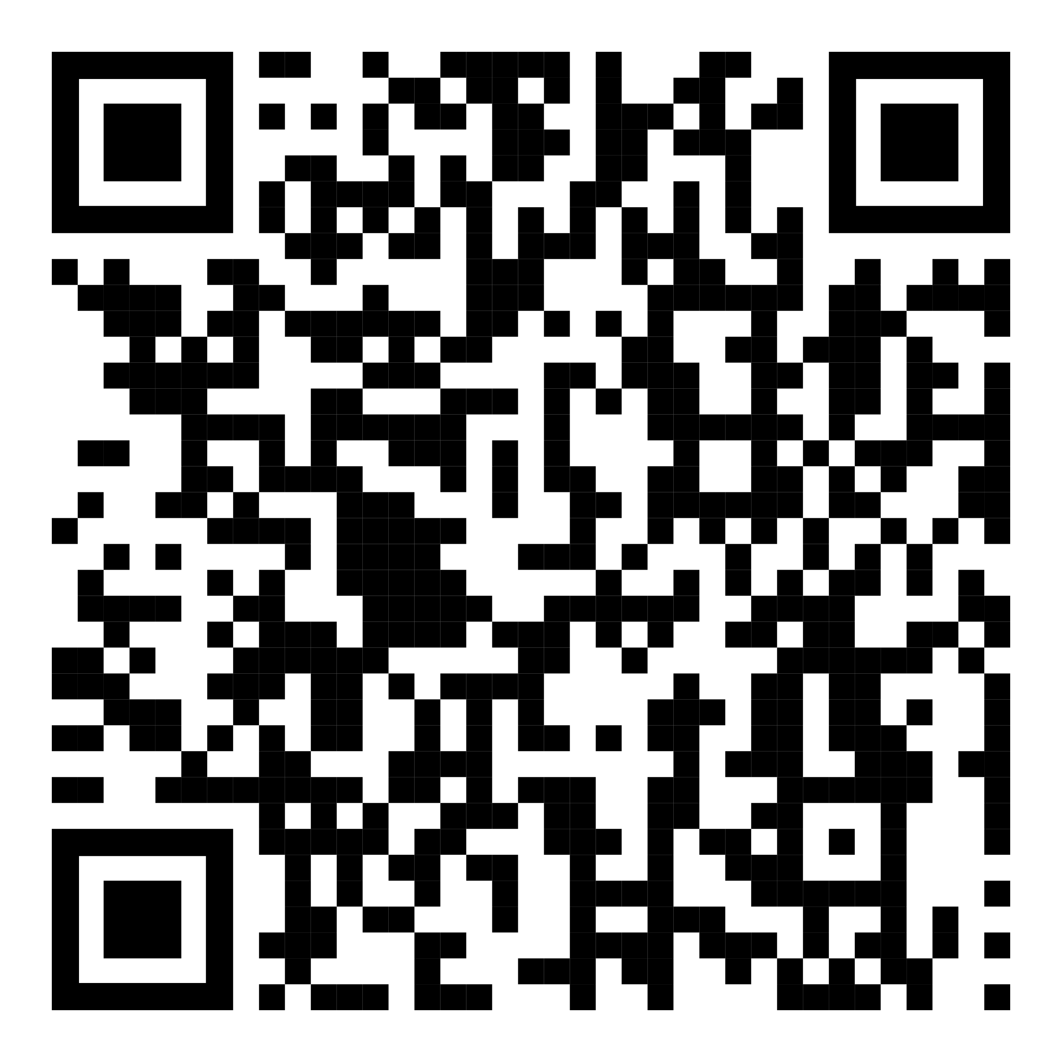
https://github.com/isidore/Talks/blob/master/AgileTechnicalPractices.md

Slide 35
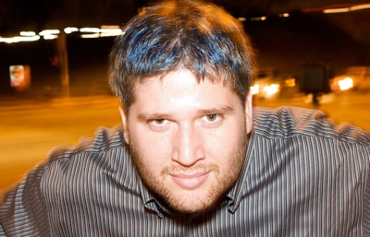
Contact
Llewellyn Falco
llewellynfalco.blogspot.com
@LlewellynFalco

